Slide 1
12
Food, Soil and Pest Management

Slide 2
Core Case Study: Growing Power – An Urban Food Oasis
Food desert
Urban area where people have little or no easy access to nutritious food
Growing Power, Inc. in Milwaukee, WI
Uses solar power
Produces 150 varieties of vegetables
Runs education program

Slide 3
Fig. 12-1, p. 278
Notes:
Figure 12-1: In 1996, Will Allen founded Growing Power—an urban farm in Milwaukee, Wisconsin.

Slide 4
12-1 What Is Food Security and Why Is It Difficult to Attain?
Many people in less-developed countries have health problems from not getting enough food, while many people in more-developed countries suffer health problems from eating too much
The greatest obstacles to providing enough food for everyone are poverty, war, bad weather, climate change, and the harmful environmental effects of industrialized food production

Slide 5
Poverty Is the Root Cause of Food Insecurity
Food security
All or most people in a country have daily access to enough nutritious food to lead active and healthy lives
Food insecurity
Chronic hunger and poor nutrition
Causes:
Political upheaval, war, corruption, and bad weather

Slide 6
Many People Suffer from Chronic Hunger and Malnutrition
Macronutrients
Carbohydrates
Proteins
Fats
Micronutrients
Vitamins
Minerals

Slide 7
Many People Suffer from Chronic Hunger and Malnutrition (cont’d.)
Chronic undernutrition
Not enough food to meet basic energy needs
Chronic malnutrition
Not enough protein or other key nutrients
Famine
Severe shortage of food
Result in mass starvation, many deaths, economic chaos, and social disruption

Slide 8
Many People Do No Get Enough Vitamins and Minerals
Most often vitamin and mineral deficiencies in people in less-developed countries
Iron
Anemia
Iodine
Essential for thyroid function

Slide 9
Many People Have Health Problems from Eating Too Much
Overnutrition
Excess body fat from too many calories and not enough exercise
Similar health problems to those who are underfed
Lower life expectancy
Greater susceptibility to disease and illness
Lower productivity and life quality

Slide 10
12-2 How Is Food Produced?
We have used high-input industrialized agriculture and lower-input traditional agriculture to greatly increase food supplies

Slide 11
Food Production Has Increased Dramatically
Three systems produce most of our food
Croplands – 77% on 11% world’s land area
Rangelands, pastures, and feedlots – 16% on 29% of world’s land area
Aquaculture – 7%
Three main grain crops – wheat, rice, and corn
Irrigation – supply of water to crops

Slide 12
Industrialized Crop Production Relies on High-Input Monocultures
Industrialized agriculture
Heavy equipment
Large amounts of financial capital, fossil fuels, water, commercial fertilizers, and pesticides
Single crop
Goal is to steadily increase crop yield
Plantation agriculture – cash crops
Primarily in less-developed countries
Increased use of greenhouses to raise crops

Slide 13
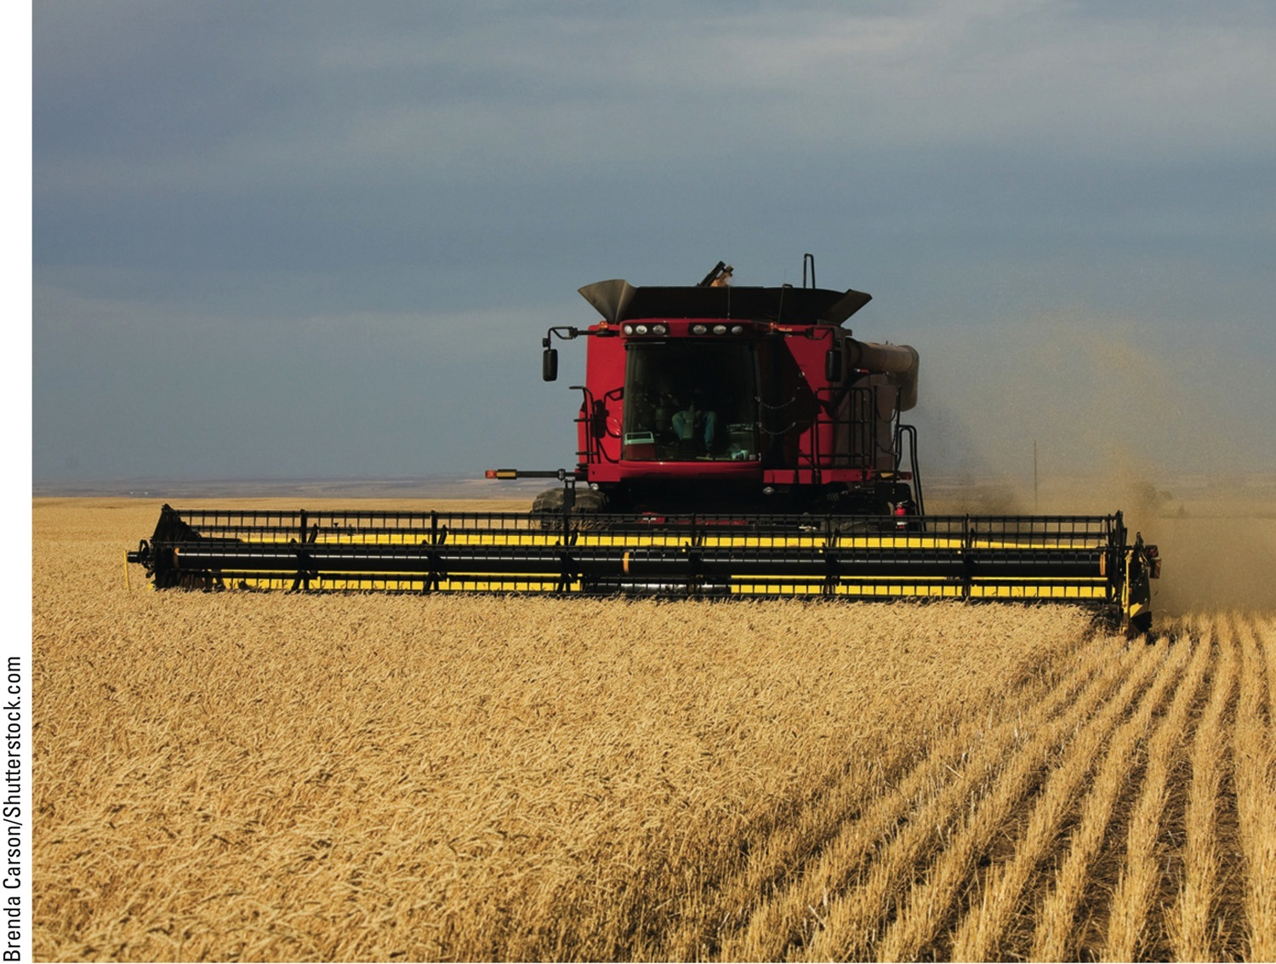
Fig. 12-4, p. 281
Notes:
Figure 12-4: This farmer, harvesting a wheat crop in the midwestern United States, relies on expensive heavy equipment and uses large amounts of seed, manufactured inorganic fertilizer, and fossil fuels to produce the crop.

Slide 14
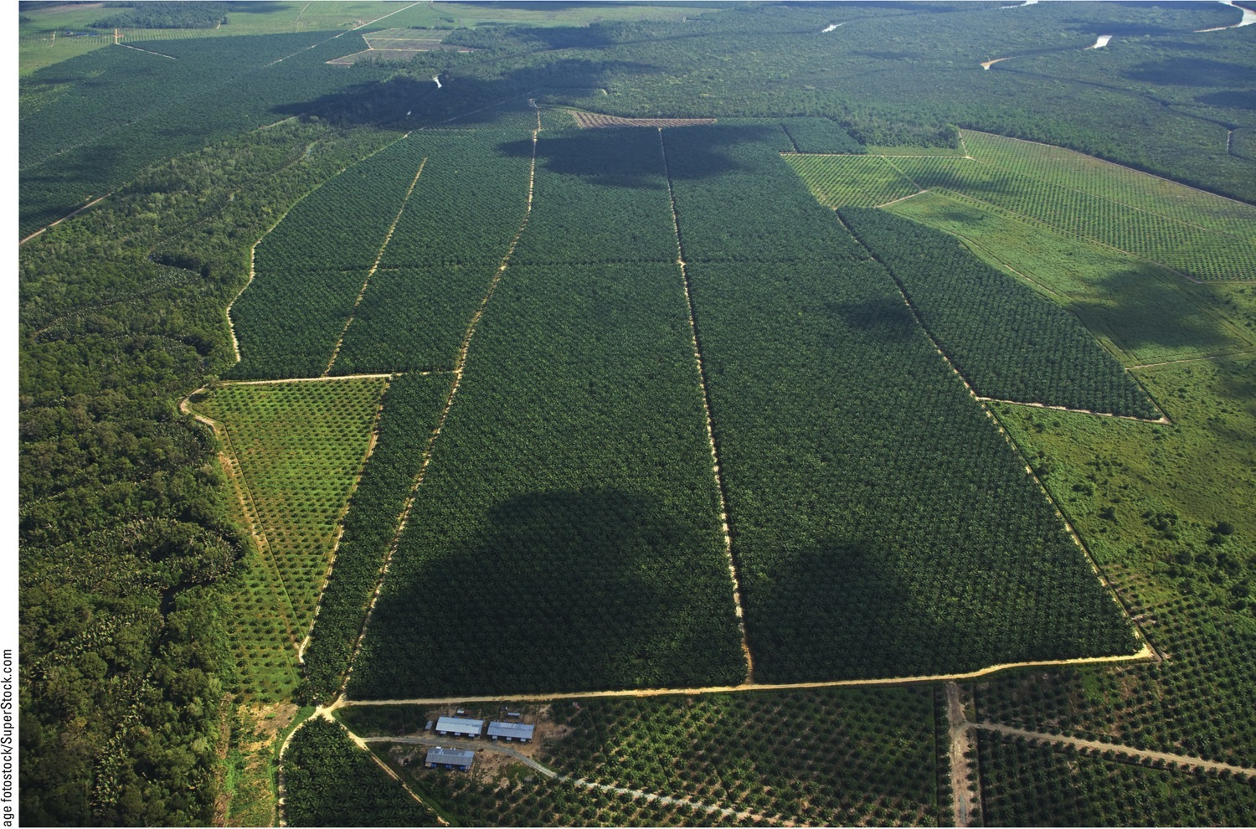
Fig. 12-5, p. 282
Notes:
Figure 12-5: These large plantations of oil palms on the island of Borneo in Malaysia were planted in an area once covered with tropical rain forest, as seen on the left side of this photo.

Slide 15
Traditional Agriculture Often Relies on Low-Input Polycultures
Traditional subsistence agriculture
Human labor and draft animals for family food
Traditional intensive agriculture
Higher yields through use of manure and water
Polyculture
Crop diversity
Benefits over monoculture

Slide 16
Traditional Agriculture Often Relies on Low-Input Polycultures (cont’d.)
Slash-and-burn agriculture
Subsistence agriculture in tropical forests
Clear and burn a small plot
Grow many crops that mature at different times
Reduced soil erosion
Less need for fertilizer and water

Slide 17
Organic Agriculture Is on the Rise
Crops grown with ecologically sound and sustainable methods
No synthetic pesticides or fertilizers
Has a number of environmental advantages
Usually produces less than conventional agriculture

Slide 18
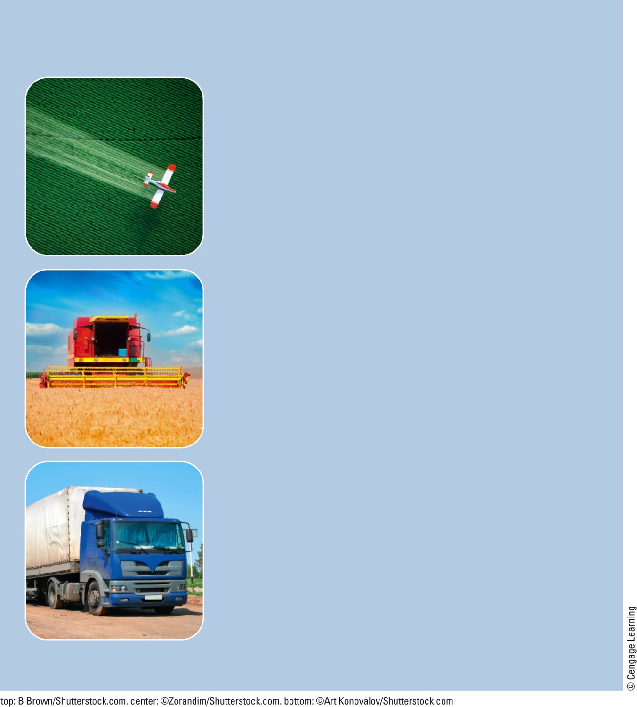
Industrialized Agriculture
Uses synthetic inorganic fertilizers and sewage sludge to supply plant nutrients
Makes use of synthetic chemical pesticides
Uses conventional and genetically modified seeds
Depends on nonrenewable fossil fuels (mostly oil and natural gas)
Produces significant air and water pollution and greenhouse gases
Is globally export-oriented
Uses antibiotics and growth hormones to produce meat and meat products
Fig. 12-7a, p. 283
Notes:
Figure 12.7 There are major differences between industrialized agriculture and organic agriculture, as summarized here.

Slide 19
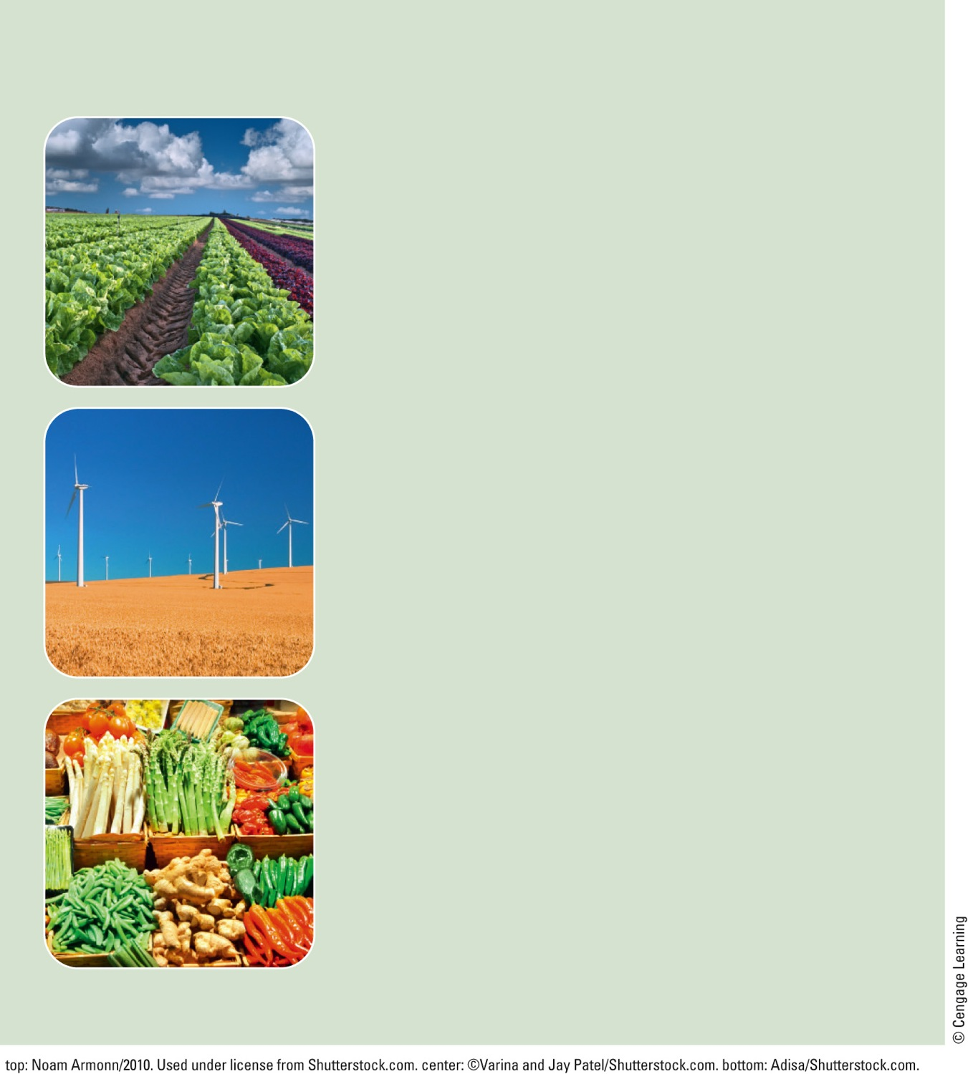
Organic Agriculture
Emphasizes prevention of soil erosion and the use of organic fertilizers such as animal manure and compost, but no sewage sludge to help replace lost plant nutrients
Employs crop rotation and biological pest control
Uses no genetically modified seeds
Reduces fossil fuel use and increases use of renewable energy such as solar and wind power for generating electricity
Produces less air and water pollution and greenhouse gases
Is regionally and locally oriented
Uses no antibiotics or growth hormones to produce meat and meat products
Fig. 12-7b, p. 283
Notes:
Figure 12.7 There are major differences between industrialized agriculture and organic agriculture, as summarized here.

Slide 20
A Closer Look at Industrialized Crop Production
Green Revolution – increase crop yields
Monocultures of high-yield key crops
Rice, wheat, and corn
Large amounts of fertilizers, pesticides, water
Multiple cropping
Second Green Revolution
Fast growing dwarf varieties
World grain has tripled in production

Slide 21
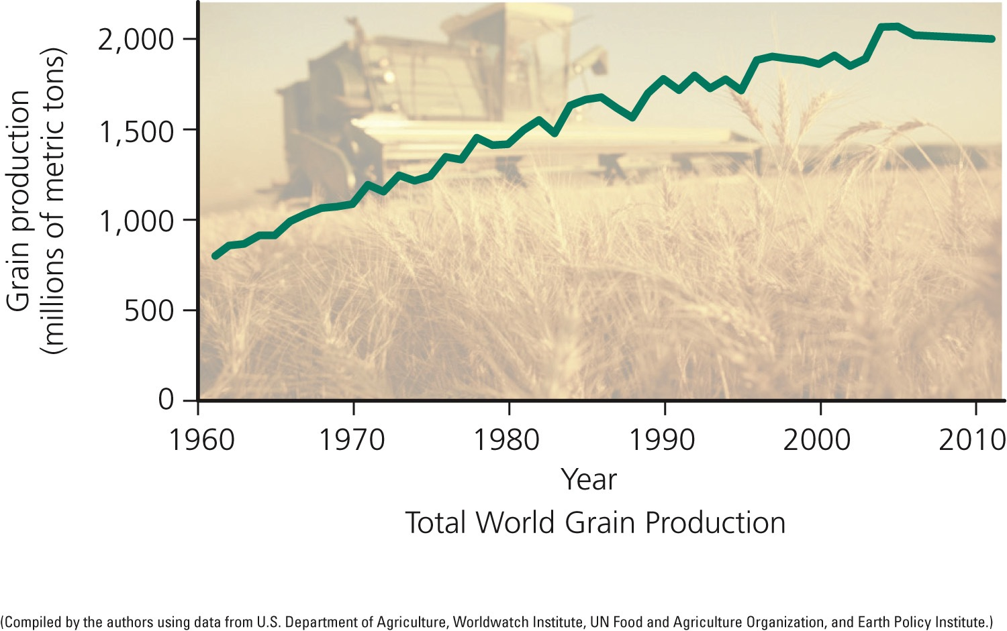
Fig. 12-8a, p. 284
Notes:
Figure 12.8 These graphs show the growth in worldwide grain production (left) of wheat, corn, and rice, and per capita grain production (right) between 1961 and 2011. Question: Why do you think grain production per capita has grown less consistently than total grain production?

Slide 22
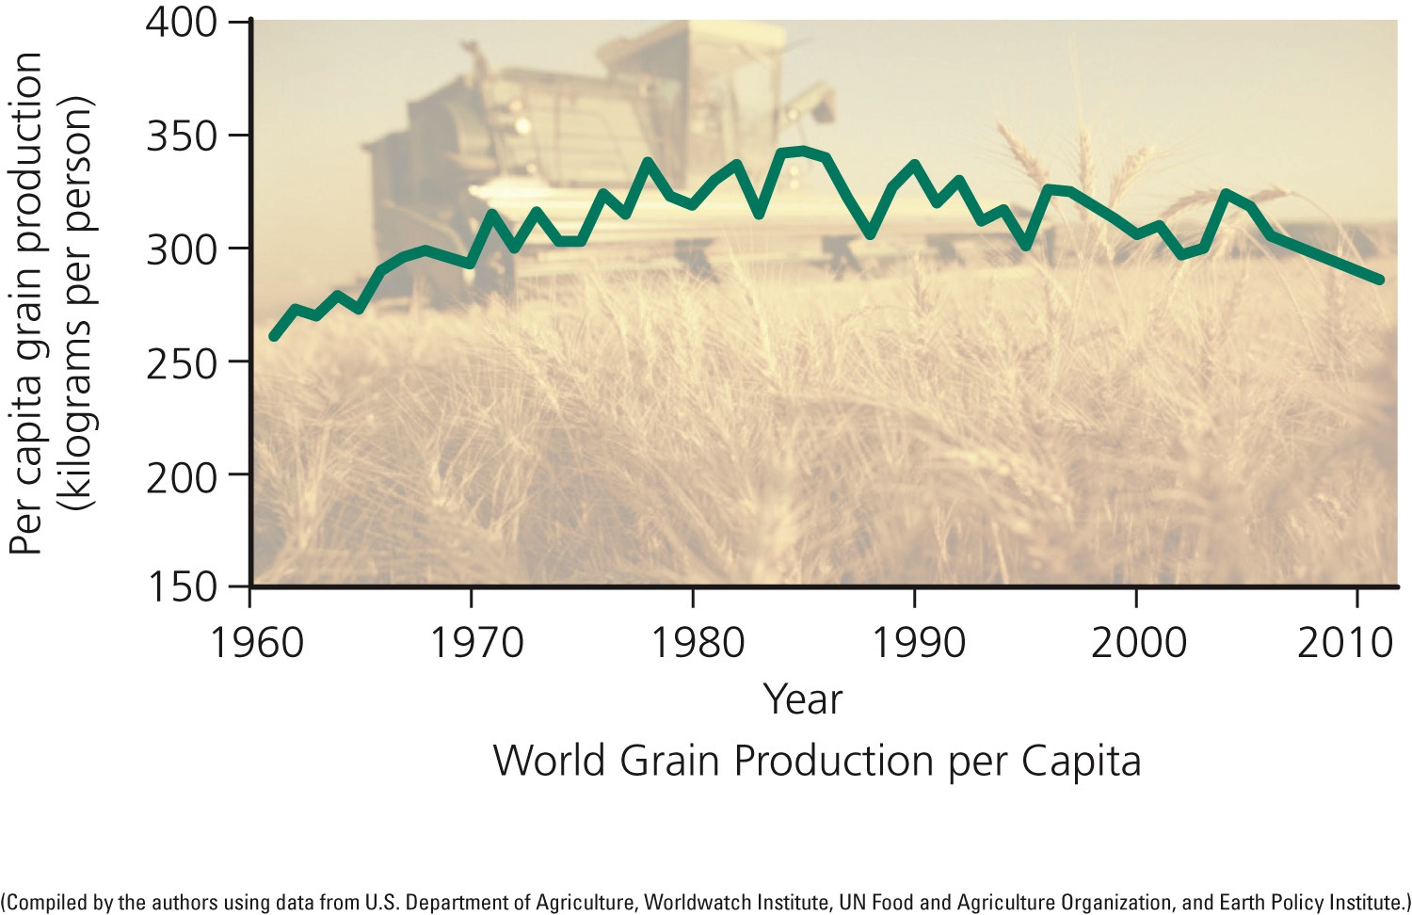
Fig. 12-8b, p. 284
Notes:
Figure 12.8 These graphs show the growth in worldwide grain production (left) of wheat, corn, and rice, and per capita grain production (right) between 1961 and 2011. Question: Why do you think grain production per capita has grown less consistently than total grain production?

Slide 23
Case Study: Industrialized Food Production in the United States
Agribusiness
Average farmer feeds 129 people
Annual sales greater than auto, steel, and housing combined
Food production – very efficient
Americans spend 10% of income on food
Hidden costs of subsidies and costs of pollution and environmental degradation

Slide 24
Crossbreeding/Genetic Engineering Produce New Varieties of Crops/Livestock
First gene revolution
Cross-breeding through artificial selection
Slow process
Amazing results
Genetic engineering – second gene revolution
Alter organism’s DNA
Genetic modified organisms (GMOs) – transgenic organisms

Slide 25
Meat Production Has Grown Steadily
Animals for meat raised in:
Pastures and rangelands
Feedlots
Meat production increased more than sixfold between 1950 and 2010
Increased demand for grain
Demand is expected to go higher

Slide 26
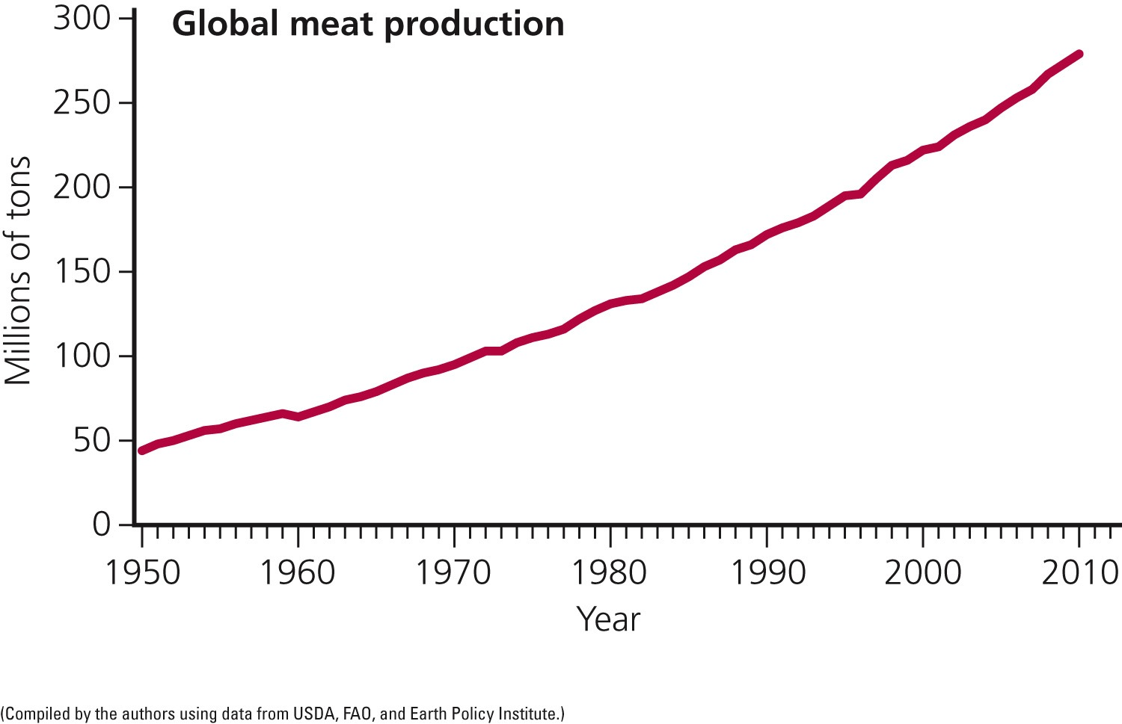
Fig. 12-9, p. 285
Notes:
Figure 12-9: Global meat production grew more than sixfold between 1950 and 2010.

Slide 27
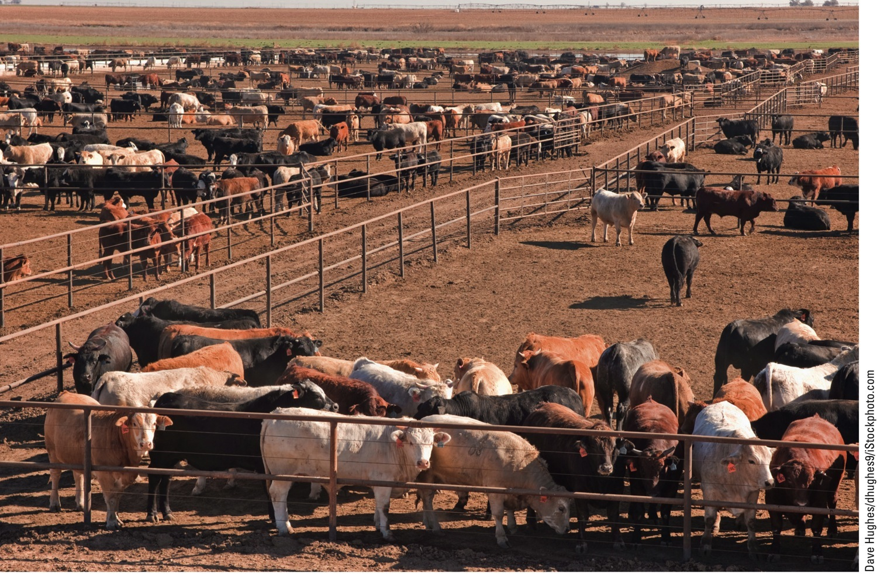
Fig. 12-10, p. 286
Notes:
Figure 12-10: Industrialized beef production: On this cattle feedlot in west Texas, thousands of cattle are fattened on grain for a few months before being slaughtered.

Slide 28
Fish and Shellfish Production Have Increased Dramatically
Fishery
Concentration of a particular species suitable for commercial harvesting
30% are overfished
57% harvested at full capacity

Slide 29
Fish and Shellfish Production Have Increased Dramatically (cont’d.)
Aquaculture, blue revolution
World’s fastest-growing type of food production
Dominated by operations that raise herbivorous species

Slide 30
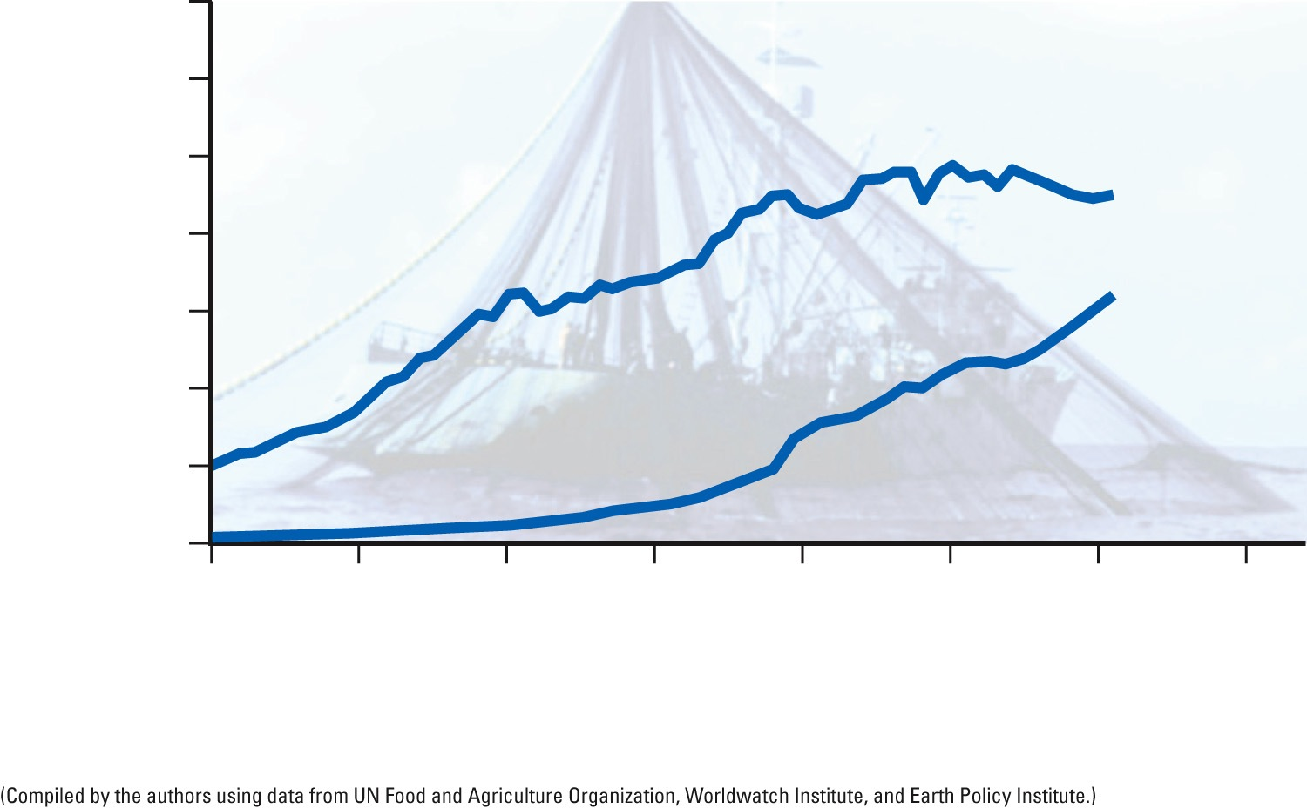
140
120
100
80
Wild catch
60
Production
(millions of metric tons)
40
Aquaculture
20
0
1950
1960
1970
1980
1990
2000
2010
2020
Year
Total World Fish Catch
Fig. 12-12, p. 287
Notes:
Figure 12-12: World seafood production, including both wild catch (marine and inland) and aquaculture, grew between 1950 and 2011, with the wild catch generally leveling off since 1996 and aquaculture production rising sharply since 1990. Question: Why do you think the wild catch has leveled off?

Slide 31
Industrialized Food Production Requires Huge Inputs of Energy
Mostly nonrenewable energy – oil and natural gas
Agriculture uses 20% of all energy use in the U.S.
Amount of energy per calorie used in the U.S. has declined 50% since the 1970s

Slide 32
12-3 What Environmental Problems Arise from Food Production?
Future food production may be limited by soil erosion and degradation, desertification, irrigation water shortages, air and water pollution, climate change, and loss of biodiversity

Slide 33
Producing Food Has Major Environmental Impacts
Agriculture has harmful affects on:
Biodiversity
Soil
Water
Air
Human health

Slide 34
Natural Capital Degradation
Food Production
Biodiversity Loss
Soil
Water
Air Pollution
Human Health
Conversion of grasslands, forests, and wetlands to crops or rangeland
Erosion
Aquifer depletion
Emissions of greenhouse gas CO₂ from fossil fuel use N₂O from inorganic fertilizer use, and methane (CH₄) from cattle
Nitrates in drinking water (blue baby)
Increased runoff, sediment pollution, and flooding from cleared land
Loss of fertility
Pesticide residues in drinking water, food, and air
Fish kills from pesticide runoff
Salinization
Pollution from pesticides and fertilizers
Killing wild predators to protect livestock
Livestock wastes in drinking and swimming water
Waterlogging
Other air pollutants from fossil fuel use and pesticide
sprays
Algal blooms and
fish kills caused
by runoff of
fertilizers and
farm wastes
Loss of genetic agrobiodiversity replaced by monoculture strains
Desertification
Bacterial contamination of meat
Fig. 12-13, p. 288
Notes:
Figure 12.13 Food production has a number of harmful environmental effects (Concept 12-3). Question: Which item in each of these categories do you believe is the most harmful?

Slide 35
Topsoil Erosion Is a Serious Problem in Parts of the World
Soil erosion
Movement of soil by wind and water
Natural causes
Human causes
Two major harmful effects of soil erosion
Loss of soil fertility
Water pollution

Slide 36
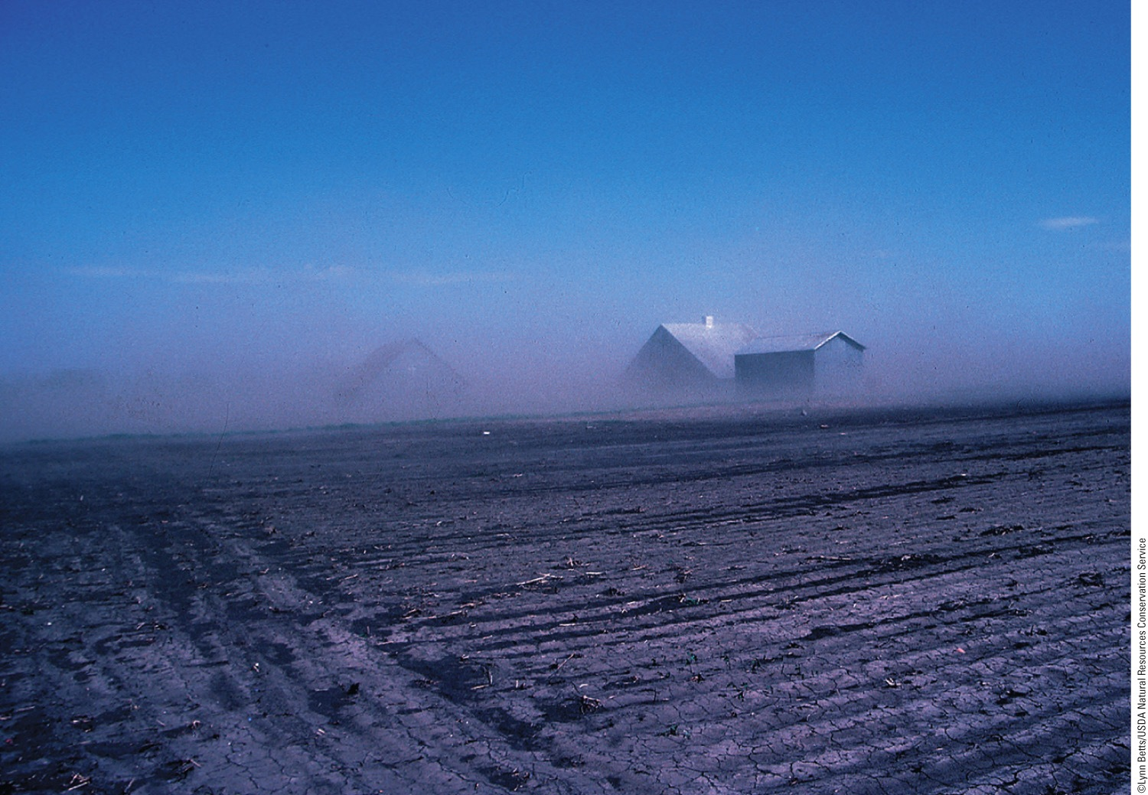
Fig. 12-15, p. 289
Notes:
Figure 12-15: Wind is an important cause of topsoil erosion in dry areas that are not covered by vegetation such as this bare crop field in the U.S. state of Iowa.

Slide 37
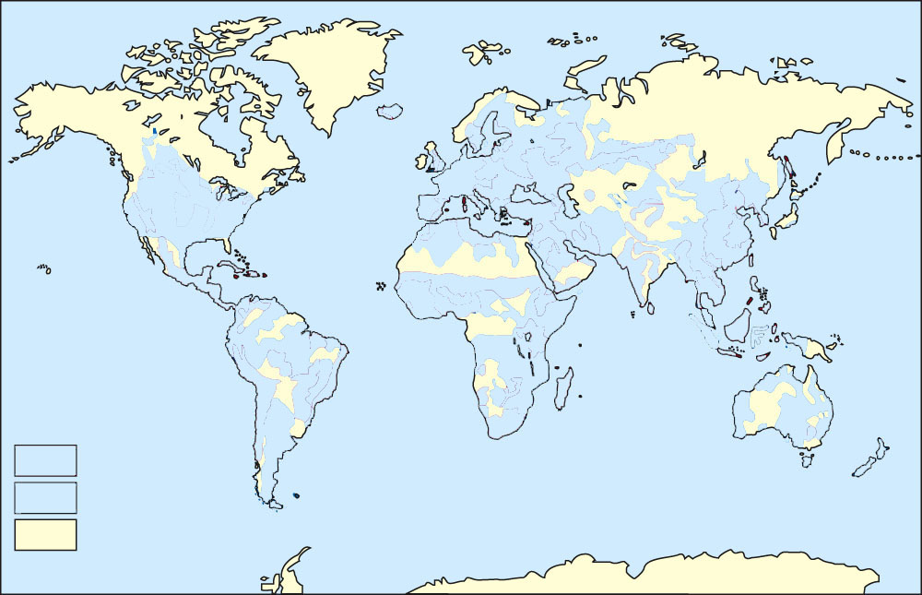
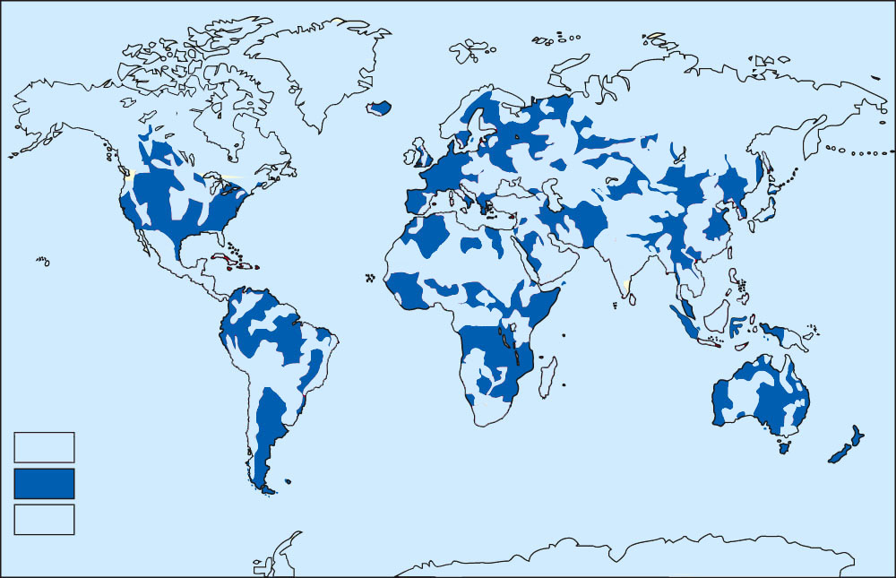
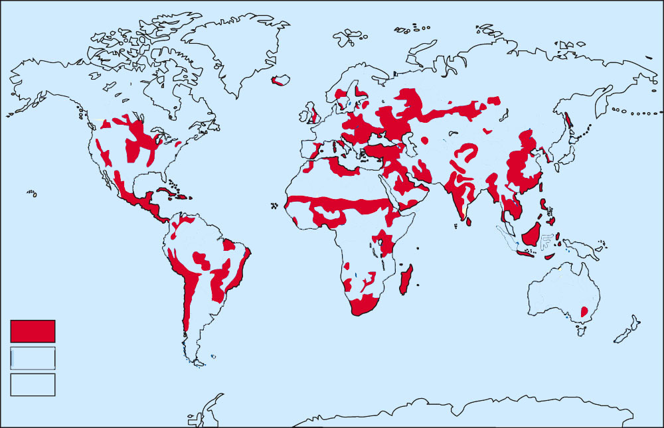
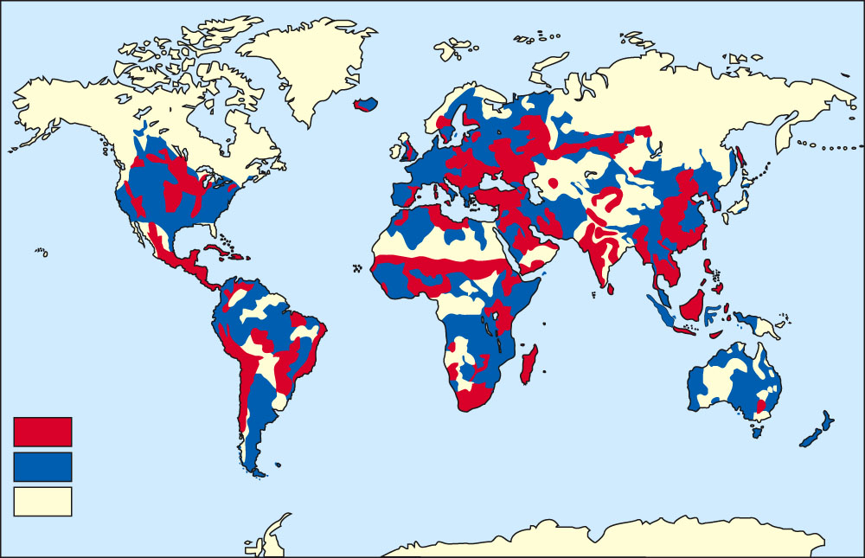
Serious concern
Some concern
Stable or nonvegetative
Stepped Art
Fig. 12-16, p. 289
Notes:
Figure 12-16: Natural capital degradation: Topsoil erosion is a serious problem in some parts of the world. Question: Can you see any geographical pattern associated with this problem?

Slide 38
Drought and Human Activities Are Degrading Drylands
Desertification
Productive potential of topsoil falls by 10% or more
Prolonged drought, human activities
Human agriculture accelerates desertification
Dust bowl
Severe wind erosion of topsoil

Slide 39
Excessive Irrigation Has Serious Consequences
Soil salinization
Gradual accumulation of salts in the soil from irrigation water
Lowers crop yields and can even kill plants
Affects 10% of world croplands
Waterlogging
Irrigation water gradually raises water table
Can prevent roots from getting oxygen
Affects 10% of world croplands

Slide 40
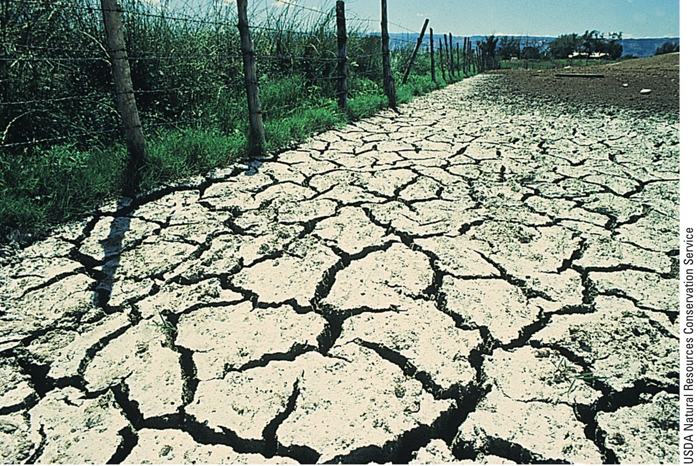
Fig. 12-18, p. 292
Notes:
Figure 12-18: Natural capital degradation. White alkaline salts have displaced crops that once grew on this heavily irrigated land in the U.S. state of Colorado.

Slide 41
Agriculture Contributes to Air Pollution and Climate Change
Clearing and burning of forests for croplands
One-fourth of all human-generated greenhouse gases
Livestock contributes 18% of gases
Methane in cow belches

Slide 42
Food and Biofuel Production Systems Have Caused Major Losses of Biodiversity
Biodiversity threatened when:
Forest and grasslands are replaced with croplands – tropical forests
Agrobiodiversity threatened when
Genetic diversity used on farms to produce food
What is the importance of seed banks?

Slide 43
There Is Controversy over Genetically Engineered Foods
Potential to solve world food problems
So far genetically modified crops have failed to provide extensive benefits
Potential environmental effects of genetically modified populations in the wild
Creating hybrids with natural organisms

Slide 44
Trade-Offs
Genetically Modified Crops and Foods
Projected Advantages
Projected
Disadvantages
May need less fertilizer, pesticides, and water
Have unpredictable genetic and ecological effects
Can be resistant to insects, disease, frost, and drought
May put toxins in food
Can promote pesticide-resistant insects, herbicide-resistant weeds, and plant diseases
Can grow faster
May tolerate higher levels of herbicides
Could disrupt seed market and reduce biodiversity
Fig. 12-19, p. 293
Notes:
Figure 12-19: Use of genetically modified crops and foods has advantages and disadvantages. Questions: Which two advantages and which two disadvantages do you think are the most important? Why?

Slide 45
There Are Limits to the Expansion of the Green Revolutions
Usually require large inputs of fertilizer, pesticides, and water
Often too expensive for many farmers
How can we expand the green revolution?

Slide 46
Industrialized Meat Production Has Harmful Environmental Consequences
Pros:
Increased meat supply
Reduced overgrazing
Kept food prices down
Cons:
Uses large amounts of water
Harmful environmental costs

Slide 47
Trade-Offs
Animal Feedlots
Advantages
Disadvantages
Increased meat production
Large inputs of grain, fish meal, water, and fossil fuels
Higher profits
Greenhouse gas (CO₂ and CH₄) emissions
Less land use
Reduced overgrazing
Concentration of animal wastes that can pollute water
Reduced soil erosion
Use of antibiotics can increase genetic resistance to microbes in humans
Protection of biodiversity
Fig. 12-20, p. 294
Notes:
Figure 12-20: Use of animal feedlots and confined animal feeding operations has advantages and disadvantages. Questions: Which single advantage and which single disadvantage do you think are the most important? Why?

Slide 48
Aquaculture Can Harm Aquatic Ecosystems
Several environmental problems
Fish are caught to feed to other fish
Inefficient process
Environmental toxins
Spread invasive plant species
Fish farms produce waste

Slide 49
Trade-Offs
Aquaculture
Advantages
Disadvantages
High efficiency
Large inputs of land, feed, and water
High yield
Large waste output
Reduced overharvesting of fisheries
Loss of mangrove forests and estuaries
Dense populations vulnerable to disease
Jobs and profits
Fig. 12-21, p. 295
Notes:
Figure 12-21: Use of aquaculture has advantages and disadvantages. Questions: Which single advantage and which single disadvantage do you think are the most important? Why?

Slide 50
12-4 How Can We Protect Crops from Pests More Sustainably?
We can sharply cut pesticide use without decreasing crop yields by using a mix of:
Cultivation techniques
Biological pest controls
Small amounts of selected chemical pesticides as a last resort (integrated pest management)

Slide 51
Nature Controls the Populations of Most Pests
Pests
Interfere with human welfare
Natural enemies control pests
Predators, parasites, disease organisms
In natural ecosystems
In many polyculture agroecosystems
What will happen if we kill the pests?

Slide 52
We Use Pesticides to Help Control Pest Populations
Pesticides
Chemicals used to kill or control populations of pests
Biopesticides
Produced by plants to ward off insects and herbivores

Slide 53
We Use Pesticides to Help Control Pest Populations (cont’d.)
First-generation pesticides
Borrowed from plants
Second-generation pesticides
Lab produced
DDT and others
Broad-spectrum and narrow-spectrum agents
Persistence varies

Slide 54
Synthetic Pesticides Have Several Advantages
Save human lives
Increases food supplies and profits for farmers
Work quickly
For many, health risks are very low relative to benefits
New pest control methods: safer and more effective

Slide 55
Synthetic Pesticides Have Several Drawbacks
Accelerate rate of genetic resistance in pests
Expensive for farmers
Some insecticides kill natural predators/ parasites that help control pests
Pollution in the environment
Some harm wildlife
Some are human health hazards

Slide 56
Trade-Offs
Conventional Chemical Pesticides
Advantages
Disadvantages
Expand food supplies
Promote genetic resistance
Can kill pests’ natural enemies and harm wildlife and people
Raise profits
Work fast
Can pollute air, water, and land
Are safe if used properly
Are expensive for farmers
Fig. 12-23, p. 297
Notes:
Figure 12-23: Use of synthetic pesticides has advantages as well as disadvantages. Questions: Which single advantage and which single disadvantage do you think are the most important? Why?

Slide 57
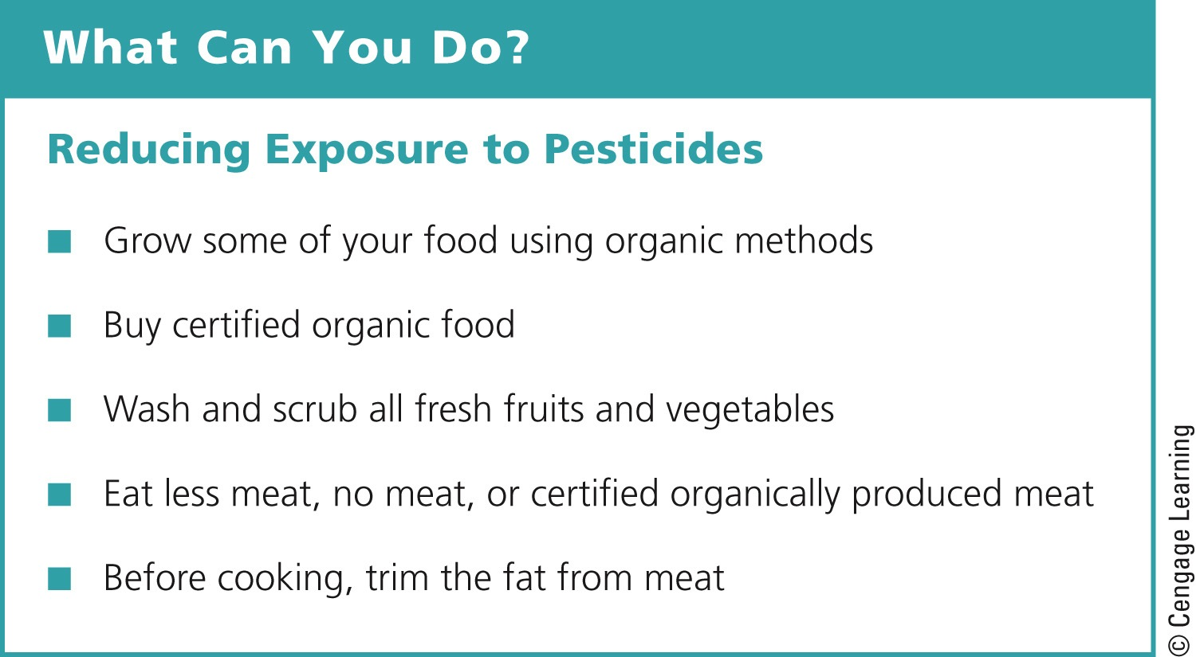
Fig. 12-24, p. 298
Notes:
Figure 12-24: Individuals matter. You can reduce your exposure to pesticides. Questions: Which three of these steps do you think are the most important ones to take? Why?

Slide 58
Case Study: Ecological Surprises: The Law of Unintended Consequences
DDT used to kill malaria-carrying mosquitoes
Have also killed other insects
Lizards
Cats
Wasps

Slide 59
Pesticide Use Has Not Reduced U.S. Crop Losses to Pests
1942-1997 – crop losses from insects increased from 7% to 13%, even with 10x increase in pesticide use
High environmental, health, and social costs with use
Use alternative pest management practices
Pesticide industry disputes these findings

Slide 60
Laws/Treaties Can Help to Protect Us from the Harmful Effects of Pesticides
U.S. federal agencies and laws
EPA, USDA, FDA
Fungicide and Rodenticide Act, 1947
Food Quality Protection Act, 1996
Effects of active and inactive pesticide ingredients are poorly documented
U.S. exports many banned pesticides
Poisons can be transmitted in the atmosphere

Slide 61
There Are Alternatives to Synthetic Pesticides
Fool the pest
Crop rotation; changing planting times
Provide homes for pest enemies
Use polyculture
Implant genetic resistance – genetic engineering
Bring in natural enemies
Predators, parasites, and diseases

Slide 62
There Are Alternatives to Synthetic Pesticides (cont’d.)
Use insect perfumes
Pheromones
Bring in hormones
Interfere with pest life cycle
Alternative methods of weed control
Crop rotation, cover crops, and mulches

Slide 63
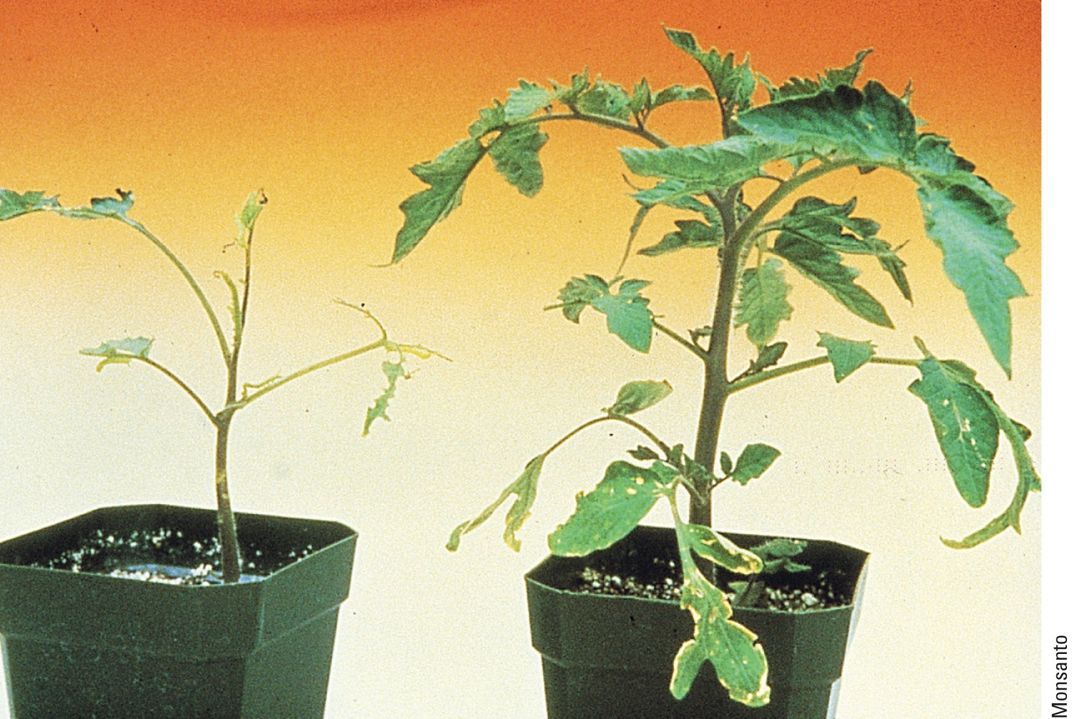
Solutions: An Example of Genetic Engineering to Reduce Pest Damage
Fig. 12-25, p. 300
Notes:
Figure 12-25: Solutions. Genetic engineering can be used to reduce pest damage. Both of these tomato plants were exposed to destructive caterpillars. The normal plant’s leaves are almost gone (left), whereas the genetically altered plant shows little damage (right). Questions: Would you have any concerns about eating the genetically engineered tomato? Why or why not?

Slide 64
IPM Is a Component of More Sustainable Agriculture
Integrated pest management (IPM)
Coordinate – cultivation, biological controls, and chemical tools to reduce crop damage to an economically tolerable level
Reduces pollution and pesticide costs
Disadvantages
Requires expert knowledge
High initial costs
Government opposition

Slide 65
12-5 How Can We Improve Food Security?
We can improve food security by reducing poverty and chronic malnutrition, relying more on locally grown food, and cutting food waste

Slide 66
Use Government Policies to Improve Food Production and Security
Control prices to make food affordable
Provide subsidies to farmers
Let the marketplace decide
Working in New Zealand and Brazil

Slide 67
Other Government/Private Programs Are Increasing Food Security
Immunizing children against childhood diseases
Prevent dehydration in infants and children
Preserve diverse gene pool

Slide 68
We Can Grow and Buy More Food Locally and Cut Food Waste
Community-supported agriculture
Buy shares of a local farmers crops
Reduce fossil fuel energy costs
Vertical farms
Potential for the future

Slide 69
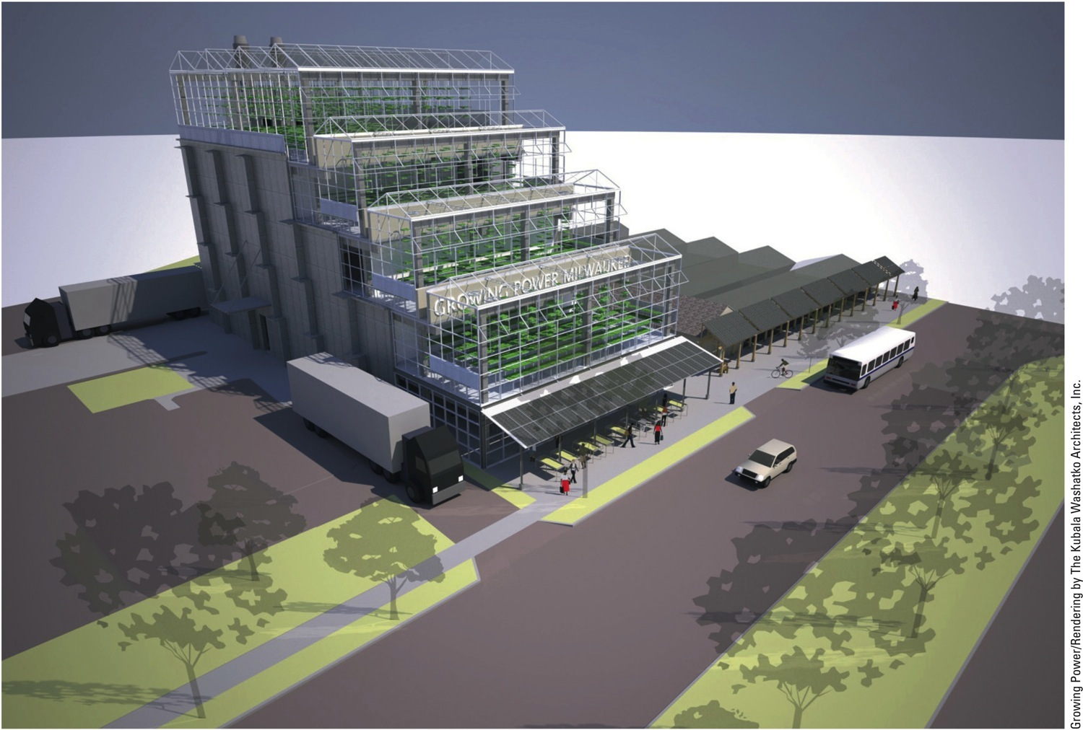
Fig. 12-27, p. 304
Notes:
Figure 12-27: A vertical farm building that could be used to grow a diversity of crops.

Slide 70
12-6 How Can We Produce Food More Sustainably?
We can produce food more sustainably by:
Using resources more efficiently
Sharply decreasing the harmful environmental effects of industrialized food production
Eliminating government subsidies that promote such harmful impacts

Slide 71
Many Farmers Are Reducing Soil Erosion
Soil conservation
Terracing
Contour planting
Strip cropping with cover crop
Alley cropping, agroforestry
Windbreaks or shelterbelts
Conservation-tillage farming
Identify erosion hotspots

Slide 72
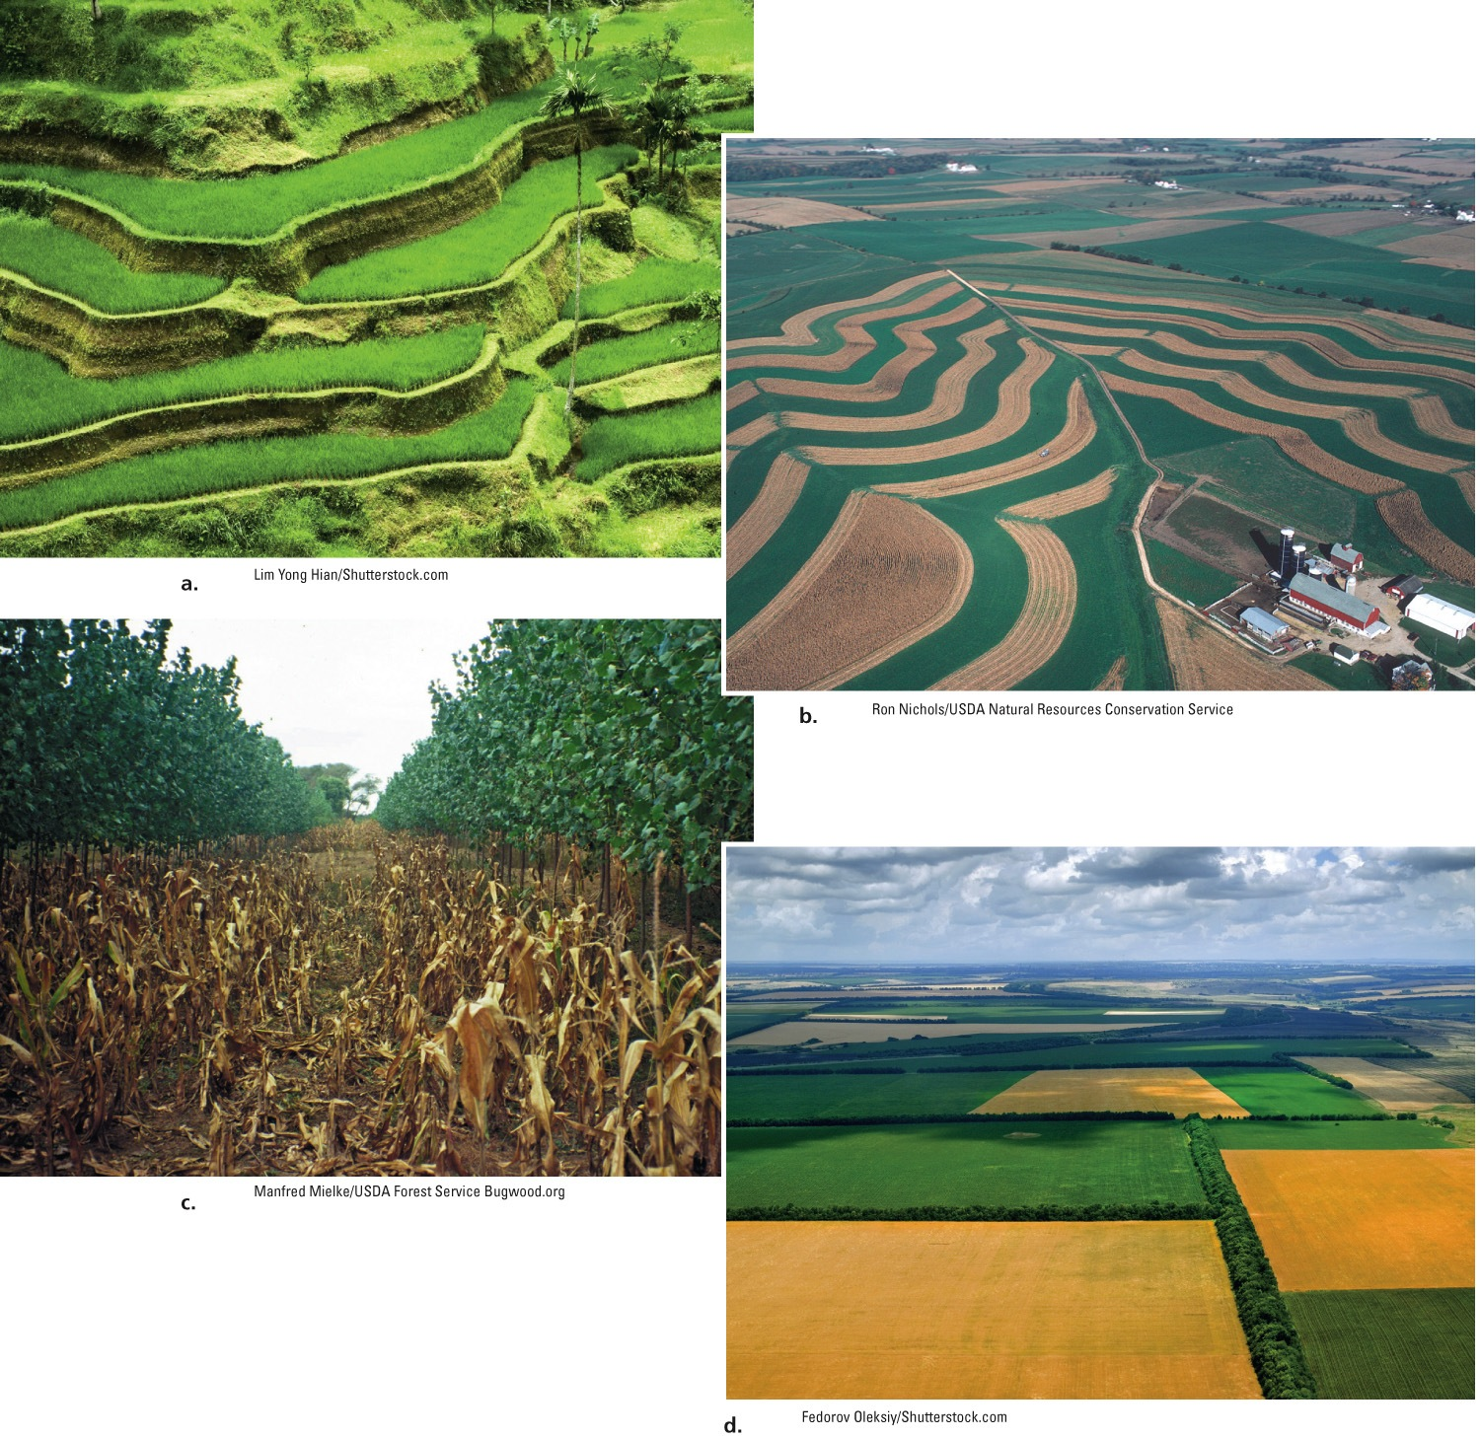
Fig. 12-28, p. 305
Notes:
Figure 12-28: Solutions. Soil conservation methods include (a) terracing; (b) contour planting and strip cropping; (c) alley cropping; and (d) windbreaks between crop fields.

Slide 73
We Can Restore Soil Fertility
Organic fertilizer
Animal manure
Green manure
Compost
Manufactured inorganic fertilizer
Nitrogen, phosphorus, and calcium
Crop rotation

Slide 74
We Can Reduce Soil Salinization and Desertification
Soil salinization
Costly solutions
Desertification
Decrease:
Population growth
Overgrazing
Deforestation
Destructive forms of planting, irrigation, and mining

Slide 75
Solutions
Soil Salinization
Prevention
Cleanup
Reduce irrigation
Flush soil (expensive and inefficient)
Use more efficient irrigation methods
Stop growing crops for 2–5 years
Switch to salt-tolerant crops
Install underground drainage systems
Fig. 12-29, p. 307
Notes:
Figure 12-29: There are ways to prevent soil salinization and ways to clean it up (Concept 12-6). Questions: Which two of these solutions do you think are the best ones? Why?

Slide 76
Some Producers Practice More Sustainable Aquaculture
Open-ocean aquaculture
Choose herbivorous fish
Recirculating aquaculture
Polyculture

Slide 77
Fig. 12-31, p. 308
Notes:
Figure 12-31: We can make aquaculture more sustainable and reduce its harmful effects. Questions: Which two of these solutions do you think are the best ones? Why?

Slide 78
We Can Produce Meat and Dairy Products More Efficiently
Shift to more grain-efficient forms of protein
Beef from rangelands and pastures, not feedlots
Develop meat substitutes
Eat less meat

Slide 79
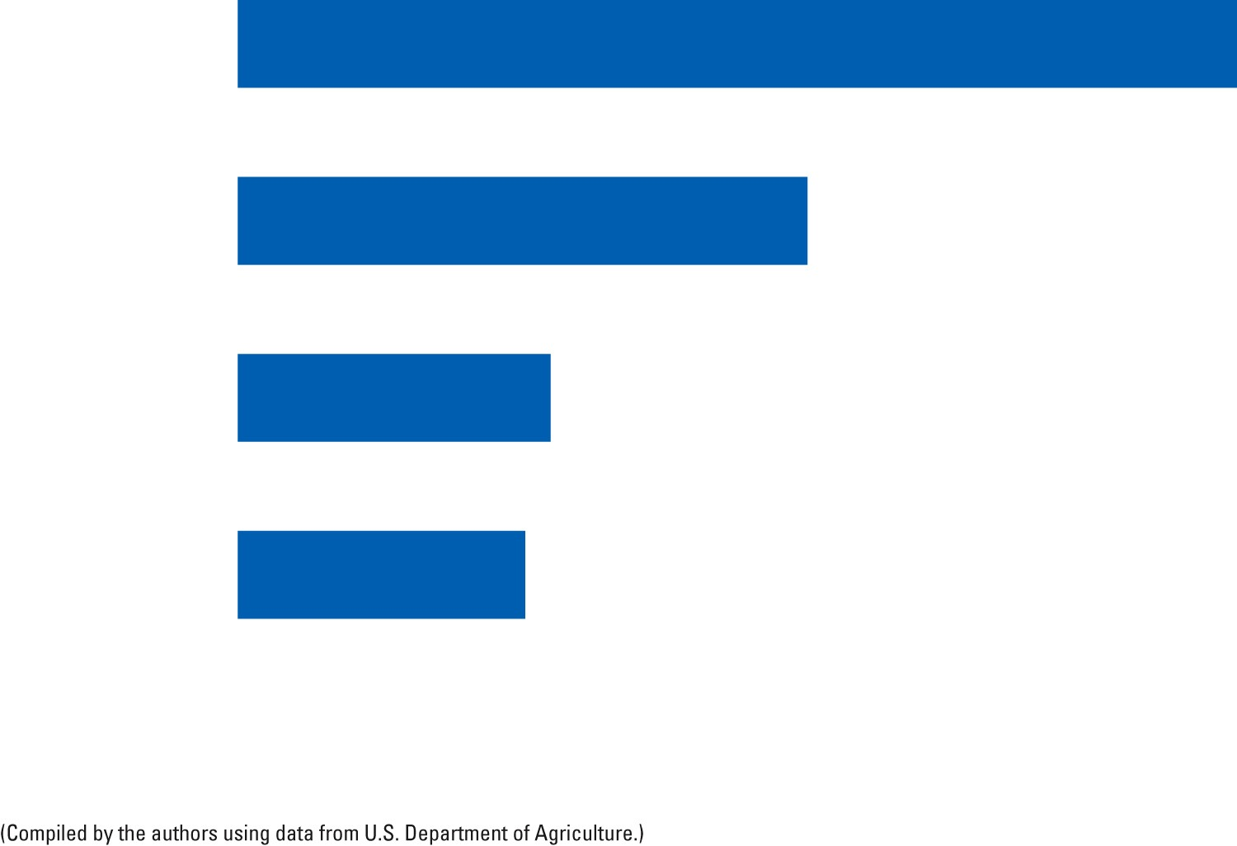
Beef cattle
7
Pigs
4
Chicken
2.2
Fish (catfish
or carp)
2
Fig. 12-32, p. 308
Notes:
Figure 12-32: Kilograms of grain required for each kilogram of body weight added for each type of animal.

Slide 80
We Can Shift to More Sustainable Food Production
Sustainable agriculture
Uses fewer inputs
Creates less pollution
Contributes less to global warming
Organic farming
Has many benefits
Requires more labor

Slide 81
We Can Shift to More Sustainable Food Production (cont’d.)
Strategies for more sustainable agriculture
Research on organic agriculture with human nutrition in mind
Education of how organic agricultural systems work
Subsidies and foreign aid
Training programs; college curricula
Increased use of hydroponics
Greater use of alternative energy

Slide 82
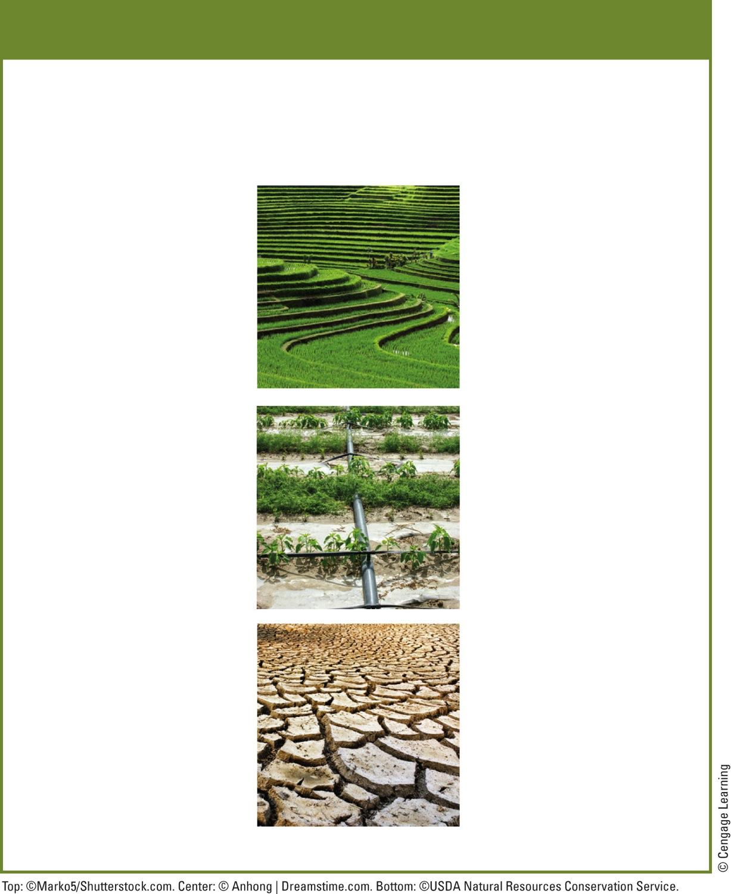
Solutions
More Sustainable Agriculture
More
Less
High-yield polyculture
Soil erosion
Soil salinization
Organic fertilizers
Biological pest control
Water pollution
Aquifer depletion
Integrated pest management
Overgrazing
Overfishing
Efficient irrigation
Loss of biodiversity and agrobiodiversity
Perennial crops
Crop rotation
Water-efficient crops
Fossil fuel use
Greenhouse gas emissions
Soil conservation
Subsidies for sustainable farming
Subsidies for unsustainable farming
Fig. 12-33, p. 309
Notes:
Figure 12-33: More sustainable, low-input food production has a number of major components. (Concept 12-6). Questions: For each list in this diagram (left and right), which two items do you think are the most important? Why?

Slide 83
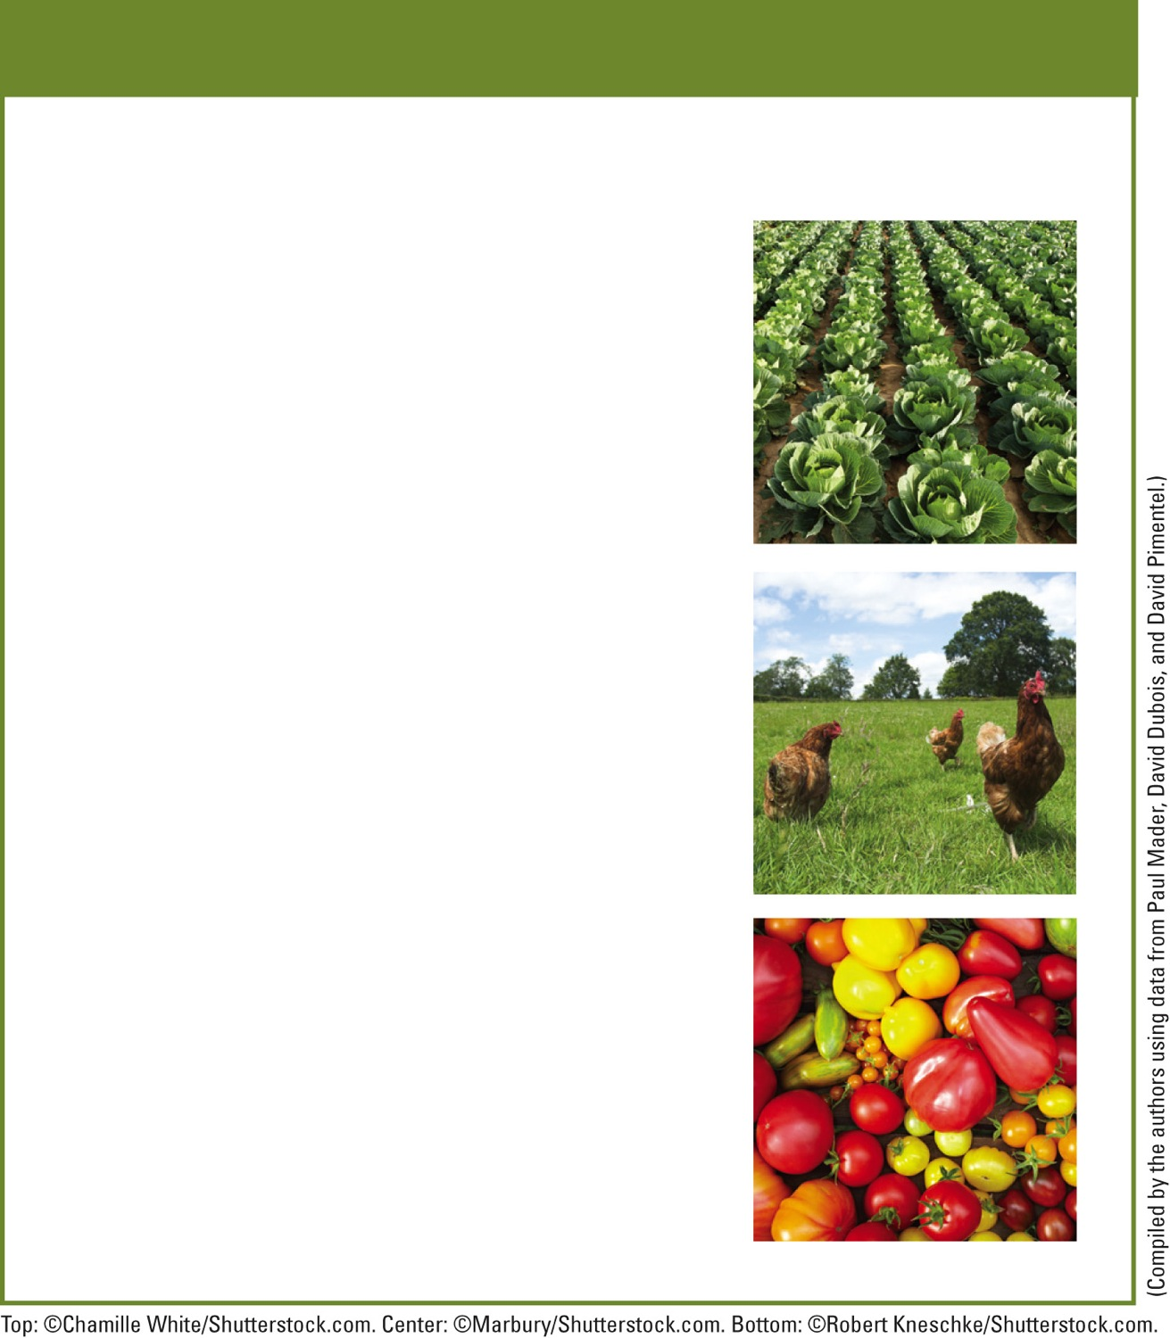
Solutions
Organic Farming
Improves soil fertility
Reduces soil erosion
Retains more water in soil during drought years
Uses about 30% less energy per unit of yield
Lowers CO₂ emissions
Reduces water pollution by recycling livestock wastes
Eliminates pollution from pesticides
Increases biodiversity above and below ground
Benefits wildlife such as birds and bats
Fig. 12-34, p. 309
Notes:
Figure 12-34: More than two decades of research have revealed some of the major advantages of organic farming over conventional industrialized farming.

Slide 84
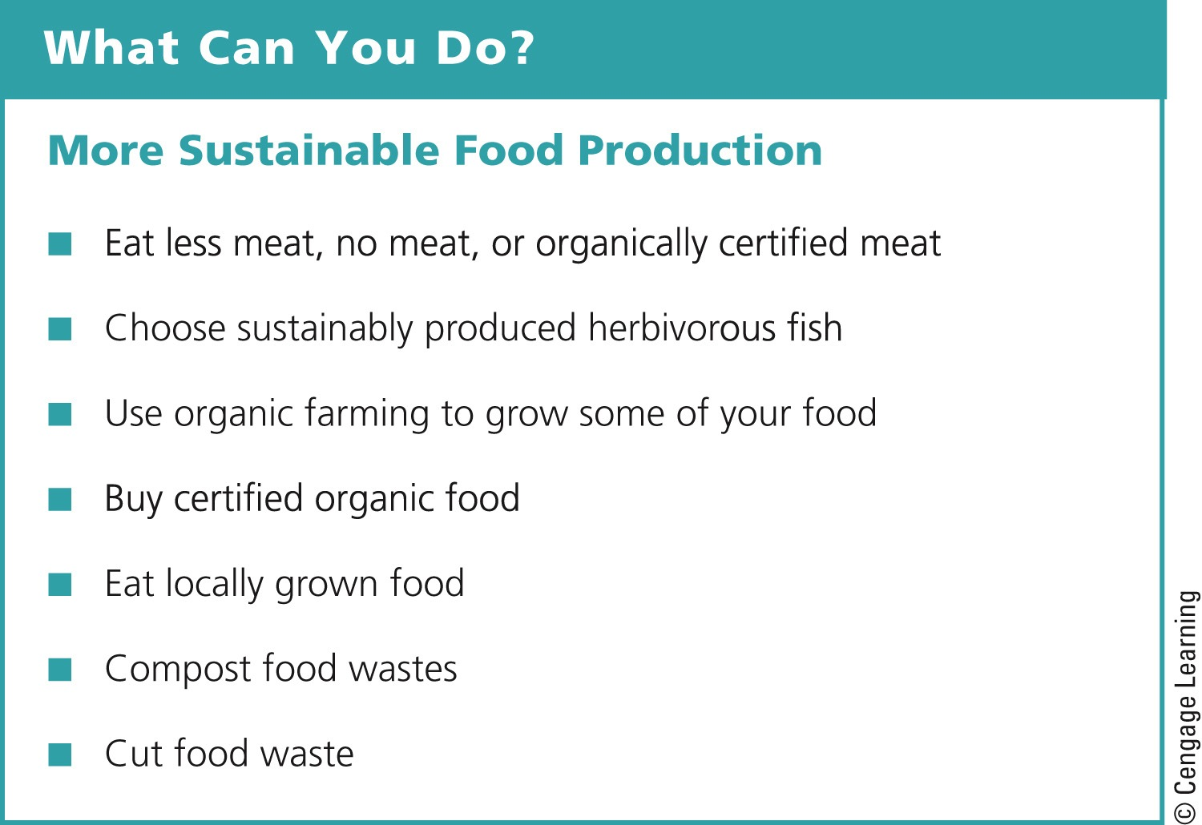
Fig. 12-36, p. 312
Notes:
Figure 12-36: Individuals matter. There are a number of ways to promote more sustainable food production (Concept 12-6). Questions: Which three of these actions do you think are the most important? Why?

Slide 85
Three Big Ideas
About 1 billion people have health problems because they do not get enough to eat and 1.6 billion people face health problems from eating too much
Modern industrialized agriculture has a greater harmful impact on the environment than any other human activity

Slide 86
Three Big Ideas (cont’d.)
We should switch to more sustainable forms of food production
Greatly reduce harmful environmental impacts of industrialized food production systems
Will likely increase food security

Slide 87
Tying It All Together: Growing Power and Sustainability
Urban farm – providing food to people in a food desert
Rely more on solar energy
Topsoil conservation
Organic pest control

